Slide 1
Compression II

Slide 2
Non-Binary Huffman Code
r is the radix of our number system. r = 2 (binary) says every interior node has two edges labeled 0 and 1 where {0,1} is the alphabet. r = 3 says every interior node has three edges labeled 0, 1, and 2.
number of characters = r + a(r-1) where r = size of alphabet and a an integer. If a is not an integer increase the number of symbols so a is an integer. These symbols are called dummies and are assigned probability 0.0.
Combine r symbols at a time when creating a new Huffman tree!

Slide 3
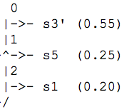
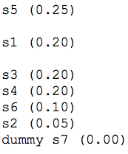
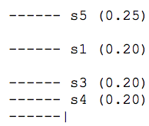



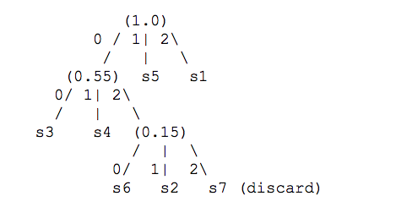
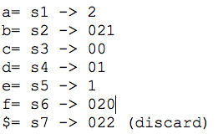
Example
Notes:
Example:
Suppose S (symbols) = {s1, s2, …, s6} and probabilities
p1 = 0.20, p2 = 0.05, p3 = 0.20, p4 = 0.20, p5 = 0.25, p6 = 0.10.
X = {0,1,2} our code alphabet this implies r = 3. So, number of symbols is 6.
Number of symbols is 6 = r + a(r-1) = 3 + 2*a but a is not an integer.
So increase the number of symbols to 7 = 3 + 2*2. Let s7 is a dummy with probability 0.00.
Now the probabilities become p1 = 0.20, p2 = 0.05, p3 = 0.20, p4 = 0.20, p5 = 0.25, p6 = 0.10, p7 = 0.0.

Slide 4

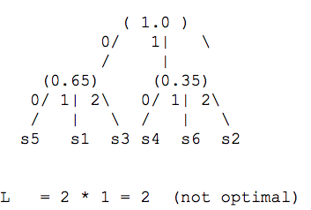
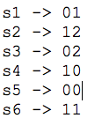
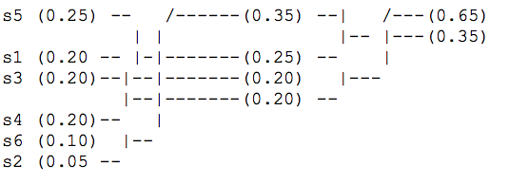
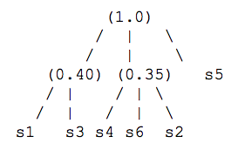
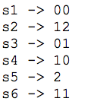
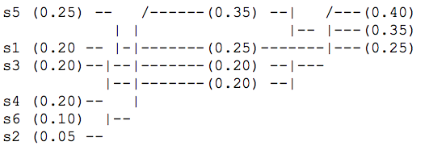
If we didn’t use dummy nodes, can we do better?
NO!
is optimal!

Slide 5
Adaptive Huffman
Adaptive Huffman refers to the process of building a Huffman code based on the characters already seen in the input. The code created from the last character seen is now reconstructed for the next character seen in the input stream. This process continues until all the characters have been seen.

Slide 6
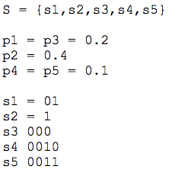
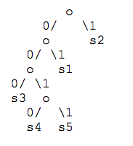

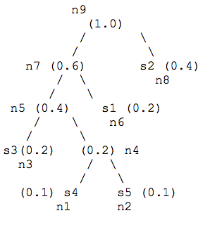

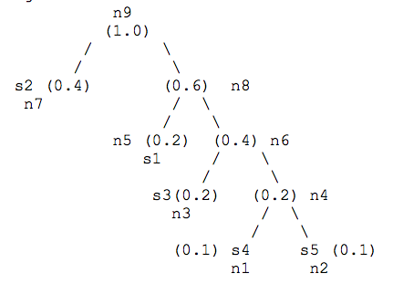
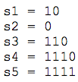
Observations
Some nodes are internal and the others are external nodes.
We wish to number the nodes using ni and represent its probability as a weight wi. The weight of an internal node is the sum of the weights of its children.
The Huffman code has changed but the sibling properties are preserved! This is how Adaptive Huffman constructs the tree after each character is seen.
This tree violates one of the sibling properties since w5 is not less or equal to w6 and w7 is not less or equal to w8!
Tree shown above

Slide 7
Adaptive Huffman Trees
Show animation

Slide 8
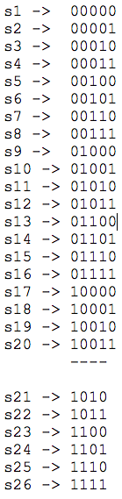

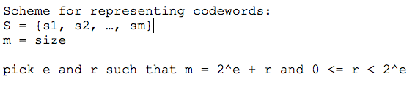

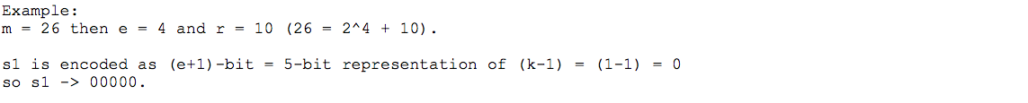
Preprocessing characters
Notes:
Note the code words from s1 to s20 have the first 4-most significant bits less than s21.
We are told that the number of bits required in a code with m code words is
ceil(lg m) which is 5-bit. But we have reduced the code words from s21 to s26 to be only 4-bits in length (a savings).

Slide 9


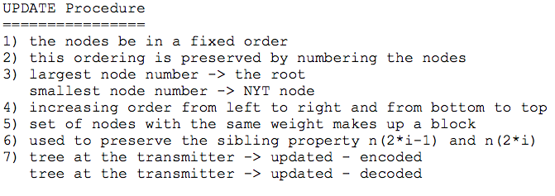
Adaptive Huffman

Slide 10
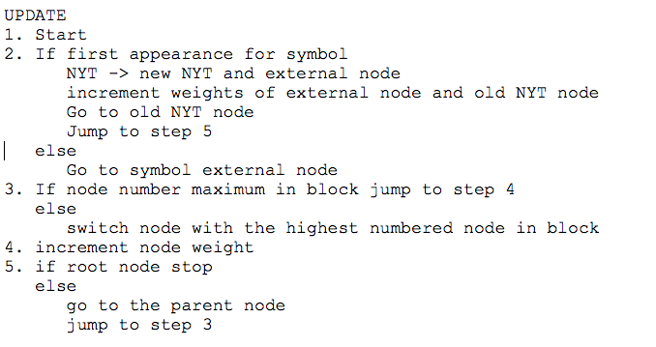
Closer Look at Update

Slide 11
Update Example (aardv)
NYT 51
0
1
51
2
51
NYT 49
0
1
a 50
NYT 49
0
2
a 50
4
51
3
51
49
2
2
a 50
1. a is received
49
1
2
a 50
2. a is received
NYT 47
47
1
1
r 48
3. r is received
0
1
r 48
NYT 45
0
1
d 46
4. d is received

Slide 12
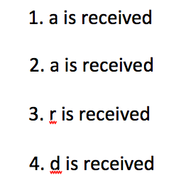
Update Example (aardv)
4
51
49
2
2
a 50
47
1
1
r 48
NYT 45
0
1
d 46
5
51
a 49
2
3
50
47 r
1
2
48
5. v is received
45
1
1
d 46
NYT 43
v 44
0
1

Slide 13
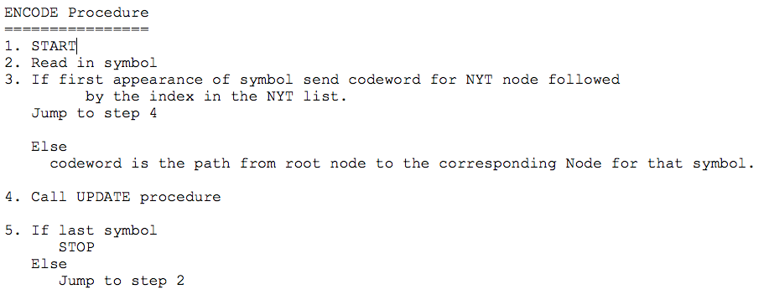
Encode

Slide 14
Encode Example (aardv)
NYT 51
0
1
51
2
51
NYT 49
0
1
a 50
NYT 49
0
2
a 50
00000 transmitted NYT a
1 transmitted
a
4
51
3
51
49
2
2
a 50
1. a is received
49
1
2
a 50
2. a is received
47 r
NYT 47
1
1
48
3. r is received
0
1
r 48
NYT 45
0
1
d 46
4. d is received
0 10001 transmitted
NYT r
00 00011 transmitted
NYT d

Slide 15
Encode Example (aardv)
4
51
49
2
2
a 50
47
1
1
r 48
NYT 45
0
1
d 46
5
51
49 a
2
3
50
47 r
1
2
48
5. v is received
45
1
1
d 46
NYT 43
v 44
000 1011 transmitted
NYT v
0
1

Slide 16
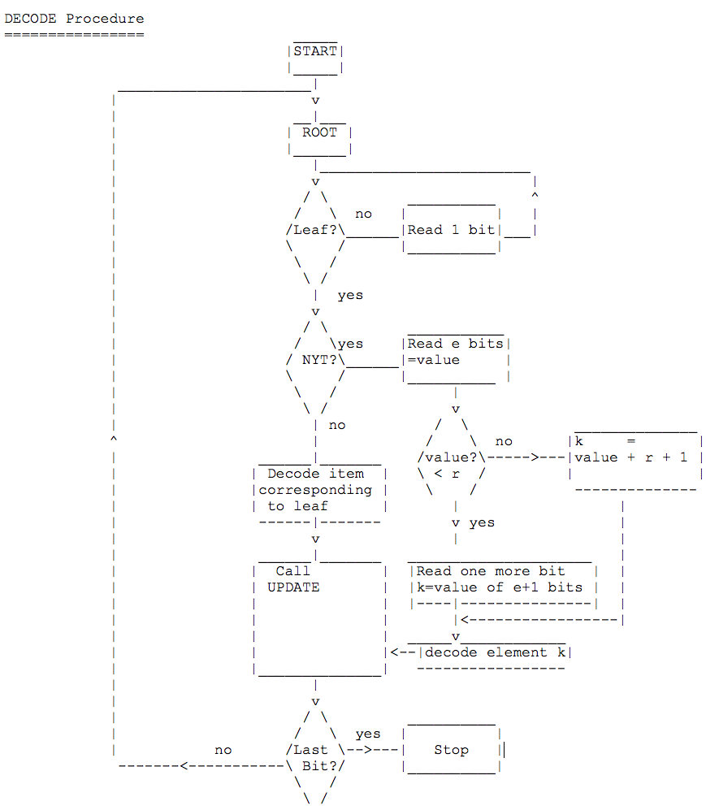
Decode

